Slide 1
Evaluating Machine Learning Model Fit for the Wisconsin Breast Cancer Data Set
Praneal Merchant
Student Number: 501068147

Slide 2
Project Introduction
Project Name: Evaluating Machine Learning Model Fit for the Wisconsin Breast Cancer Data Set
Student: Praneal Merchant
Student Number: 501068147
Notes:
The purpose of this research project was to determine which type of machine learning model is best suited to determine the characteristics in the dataset will help predict whether a breast cancer diagnosis is benign or malignant.

Slide 3








Data Analysis Tools

Slide 4
Next Steps in Analysis
Before doing any sort of comprehensive analysis, it was best to essentially “clean” the data and remove any sort of rows or columns which had ‘Null’ or ‘NaN’ values. Fortunately, my dataset did not have any missing values in any of the major categories.
However, there was a column labelled ‘Unnamed’ which served no purpose for data analysis in this instance and was removed.
To get a better understanding of the distribution of benign and malignant cases in this dataset, I created a histogram which highlighted the number of each.
After, this I did a quick run through to understand the data type of each category. It was found that the diagnosis category was initially in ‘object’ format. This was then converted to a value of ‘1’ for malignant and ‘0’ for benign. This was to help with the smoothness in further data analysis.

Slide 5
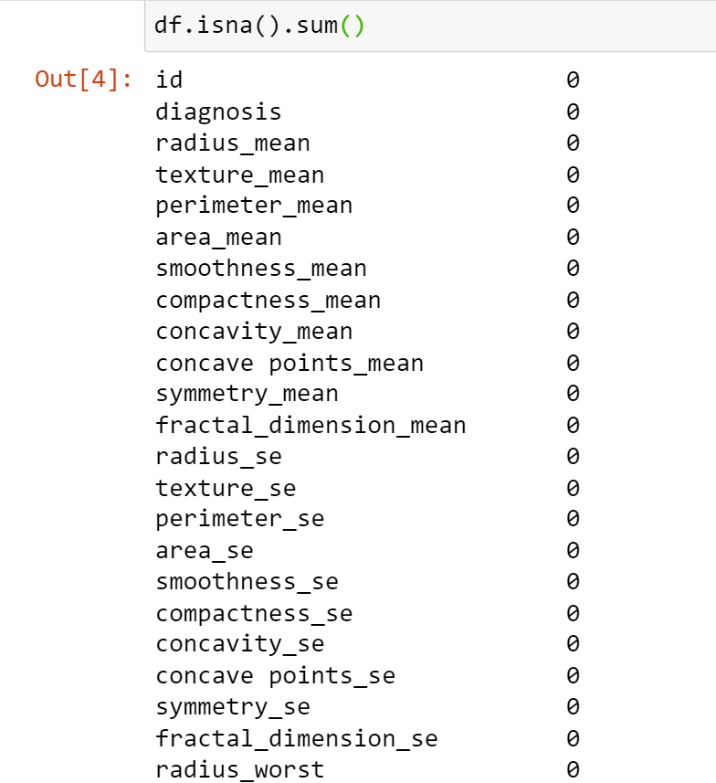
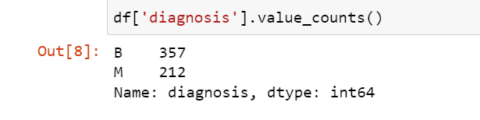
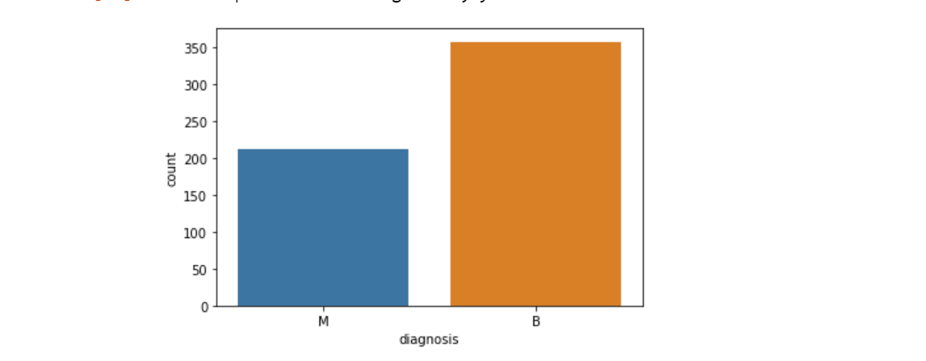
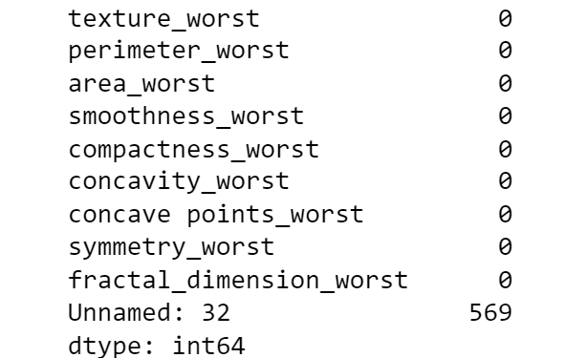
Breast Cancer Dataset
Notes:
Before doing any sort of comprehensive analysis, it was best to essentially “clean” the data and remove any sort of rows or columns which had ‘Null’ or ‘NaN’ values. Fortunately, my dataset did not have any missing values in any of the major categories. However, there was a column labelled ‘Unnamed’ which served no purpose for data analysis in this instance and was removed.
After, this I did a quick run through to understand the data type of each category. It was found that the diagnosis category was initially in ‘object’ format. After some consideration, I decided to also concert it to a numerical value of ‘1’ for malignant and ‘0’ for benign. This was to help with the smoothness in further data analysis.
To get a better understanding of the distribution of benign and malignant cases in this dataset, I created a bar chart which highlighted the number of each

Slide 6
Next Steps in Analysis
To get a preliminary understanding of what correlations may exist between characteristics in the dataset, I decided to run a code that can visualize the strength of correlations between the characteristics and the ‘diagnosis’ category.
When visualizing the correlations, I subsetted only the ‘mean’ version of all the characteristics.
Based on the scatter plot visualizations, it can be said that the radius mean, perimeter mean, texture mean and area mean have a strong linear correlation with both benign and malignant breast cancer diagnoses.

Slide 7
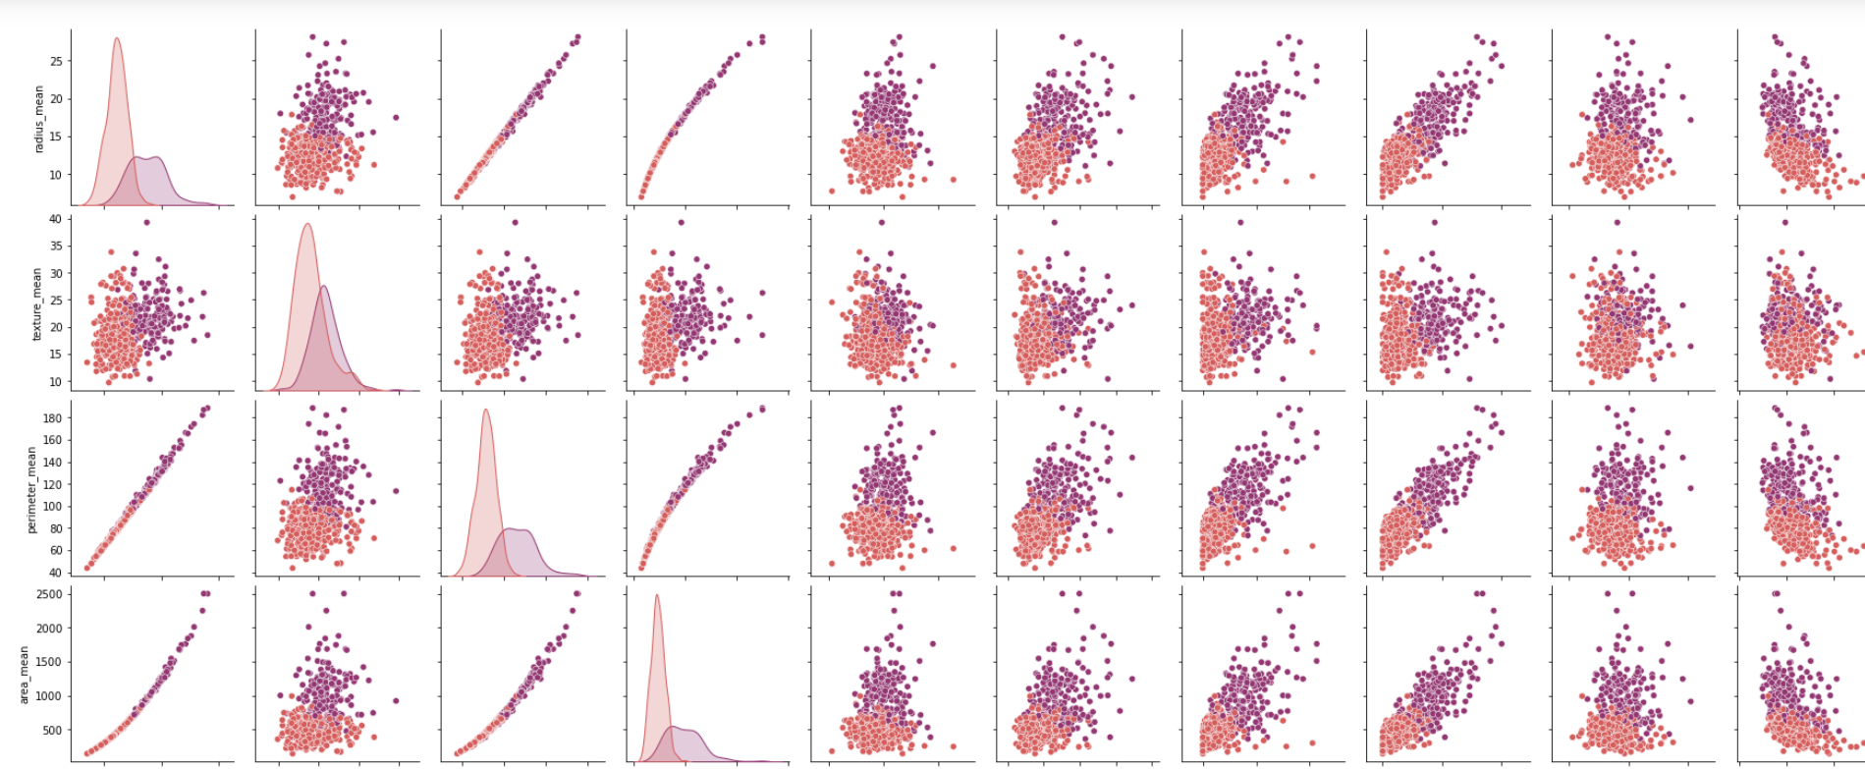
Correlations in Data

Slide 8
Next Steps in Analysis
Testing Accuracy
Evaluating Machine Learning Models
Average Cross-Validation

Slide 9
Definitions
Testing Accuracy: These scores represent how accurate the model is in identifying positive (malignant) breast cancer samples.
Evaluating Machine Learning Models
Precision- Considers all positive (malignant) samples that are classified as positive either correctly or incorrectly
Recall- Considers correctly classifying all positive samples (in this case, malignant).
Average Cross-Validation Scores: These scores represent how good a specific model can make predictions on data that is not used in the training of the model. (https://machinelearningmastery.com/k-fold-cross-validation/)

Slide 10
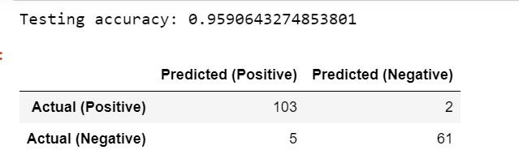
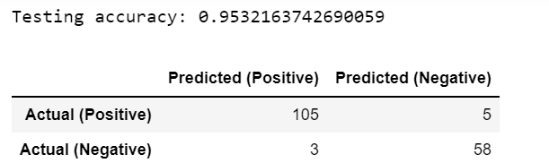
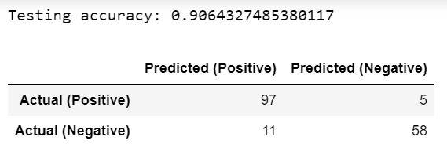
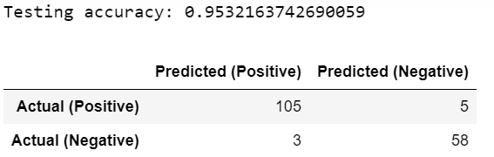
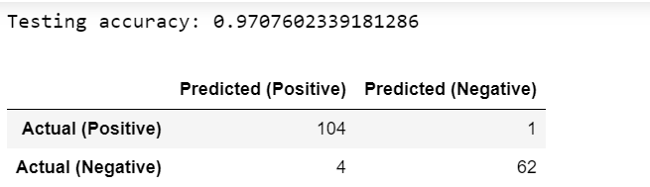
Testing Accuracy of Each Model
Logistic Regression
K-Nearest Neighbours
Decision Tree
Support Vector Machines
Random Forest

Slide 11
Testing Accuracy of Each Model
Model | Testing Accuracy
Logistic Regression | 0.9590643274853801
Decision Tree | 0.9064327485380117
Random Forest | 0.9707602339181286
K-Nearest Neighbours | 0.9532163742690059
Support Vector Machines | 0.9532163742690059

Slide 12
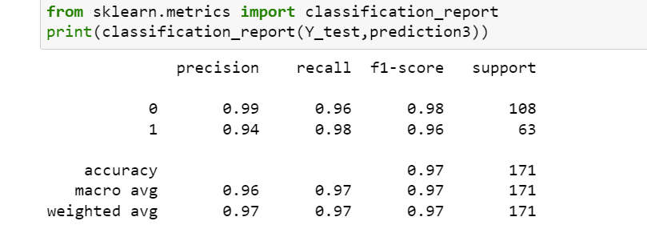
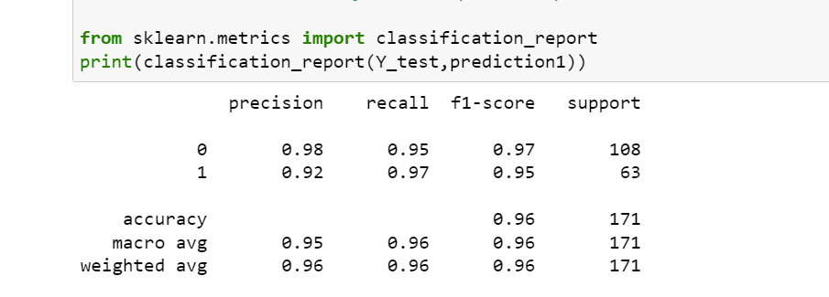
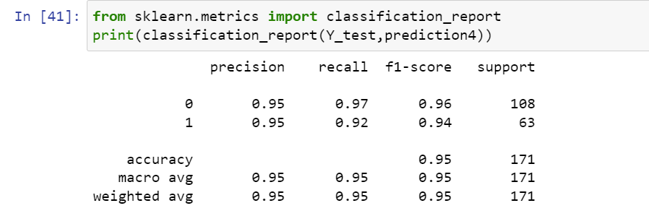
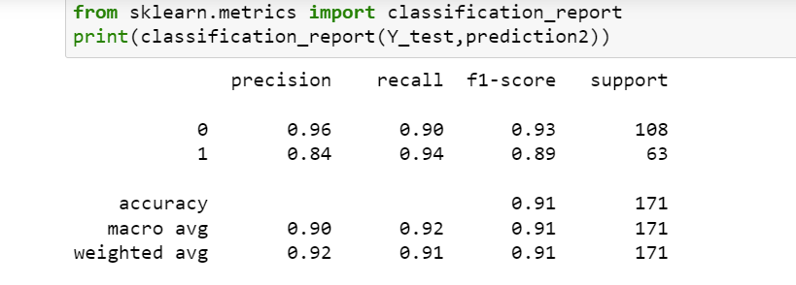
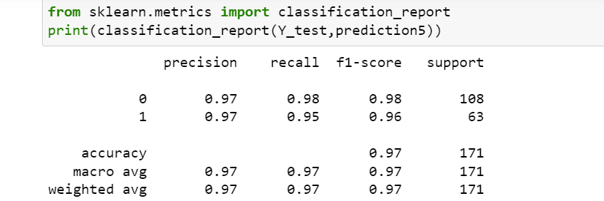
Evaluating Machine Learning Models
Random Forest
Logistic Regression
K-Nearest Neighbours
Decision Tree
Support Vector Machines
Notes:
In Precision, we should consider all positive samples that are classified as positive either correctly or incorrectly. The recall cares about correctly classifying all positive samples (in this case, malignant).

Slide 13
 | Precision | Recall
Logistic Regression
Benign | 0.98 | 0.95
Malignant | 0.92 | 0.97
Decision Tree
Benign | 0.96 | 0.90
Malignant | 0.84 | 0.94
Random Forest
Benign | 0.99 | 0.96
Malignant | 0.94 | 0.98
K-Nearest Neighbours
Benign | 0.95 | 0.97
Malignant | 0.95 | 0.92
Support Vector Machines
Benign | 0.97 | 0.98
Malignant | 0.97 | 0.95

Slide 14
Average Cross-Validation Scores
Model | Average Score
Logistic Regression | 0.9248571428571427
Decision Tree | 0.6131190476190476
Random Forest | 0.7965238095238095
K-Nearest Neighbours | 0.8283571428571429
Support Vector Machine | 0.9146666666666666

Slide 15
What can be learned?
The research question for this project included the following:
What characteristic or set of characteristics from the dataset influence whether the diagnosis of breast cancer is benign or malignant?
What is the best classification model to use to answer the previous research questions?
Based on plotting the correlation all the characteristics as it relates to ‘diagnosis’, it can be said that the radius mean, perimeter mean, texture mean and area mean have a strong correlation with both benign and malignant breast cancer diagnoses.
The results that were produced from my own analysis of this data set are different than what has been concluded from other academic papers.
Based on cross-validation scores, it can be concluded that for my project, using logistic regression would be the best model to help evaluate the second research question.
Although I chose specific metrics to be used in evaluating my machine learning models (ML), there are still others that can be used as a part of the evaluation of these ML models that were not used in this project.
Further analysis or different techniques may need to be used to find a definitive answer to this question.

Slide 16
Thank you for time!

